Slide 1
A Case Study in Beer
by Ben Goodwin & Justin Ehly

Slide 2
Analysis Questions
How many breweries are present in each state?
Why are there missing values?
What is the median ABV and IBU for each state?
Which state(s) has the highest ABV and which state(s) has the highest IBU values?
Provide summary statistics and distribution of ABV.
Is there a relationship between the bitterness of the beer and its alcoholic content?

Slide 3
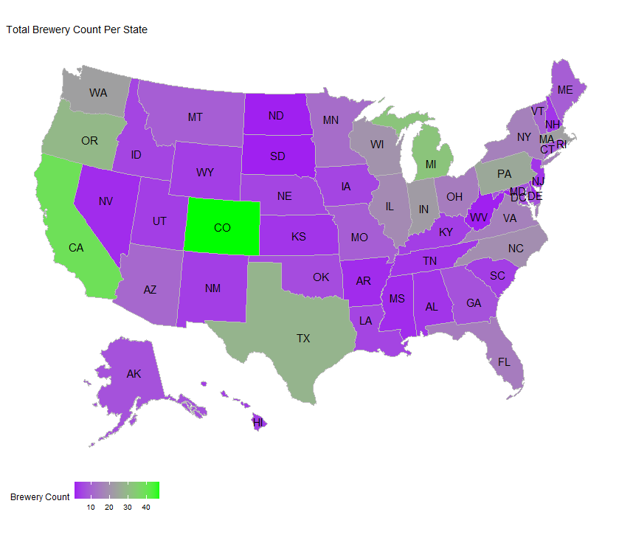
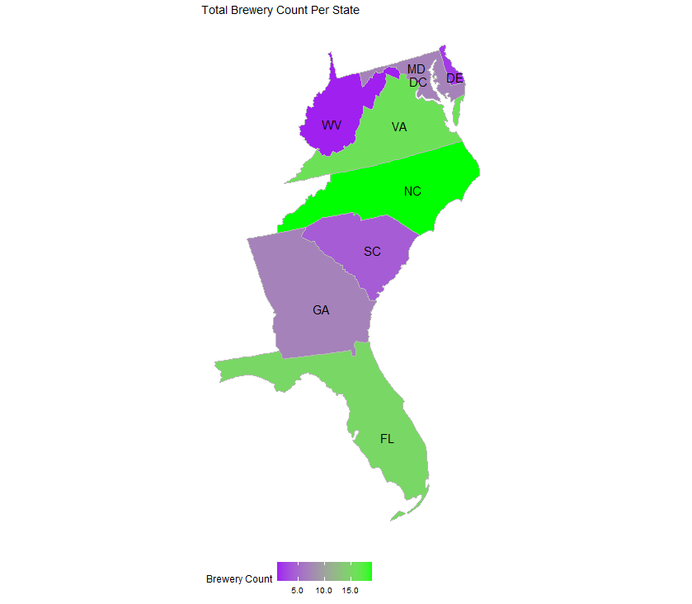
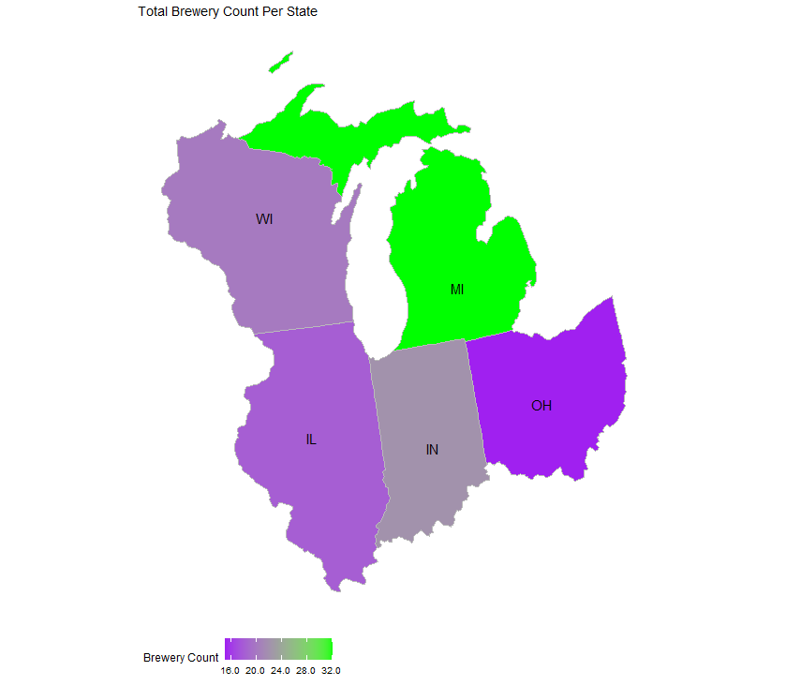
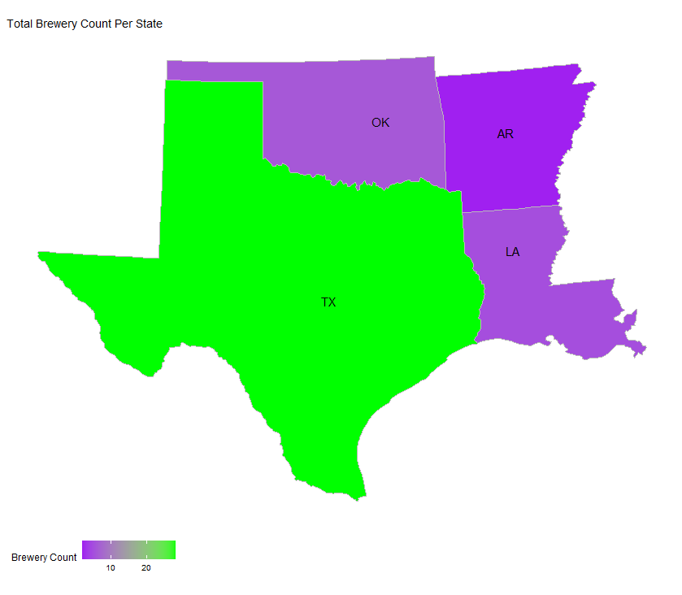
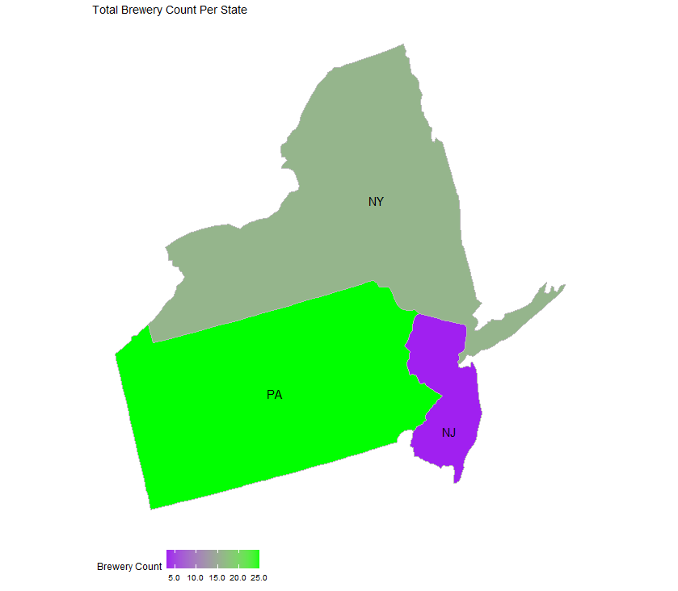
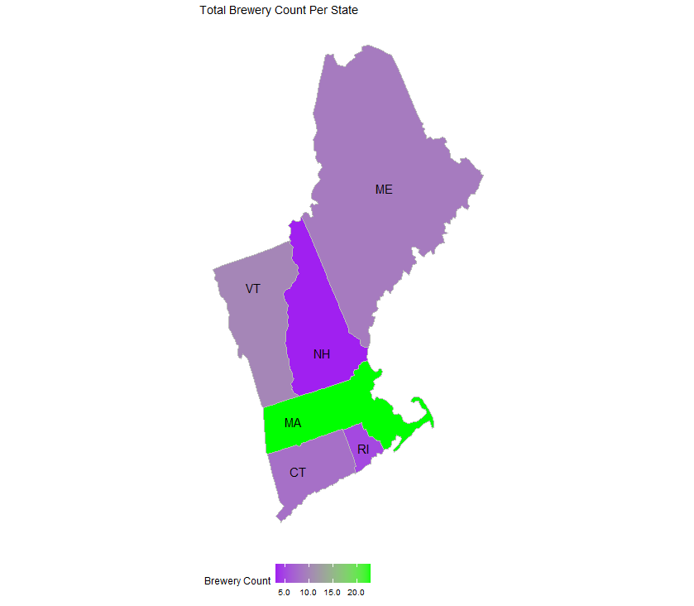
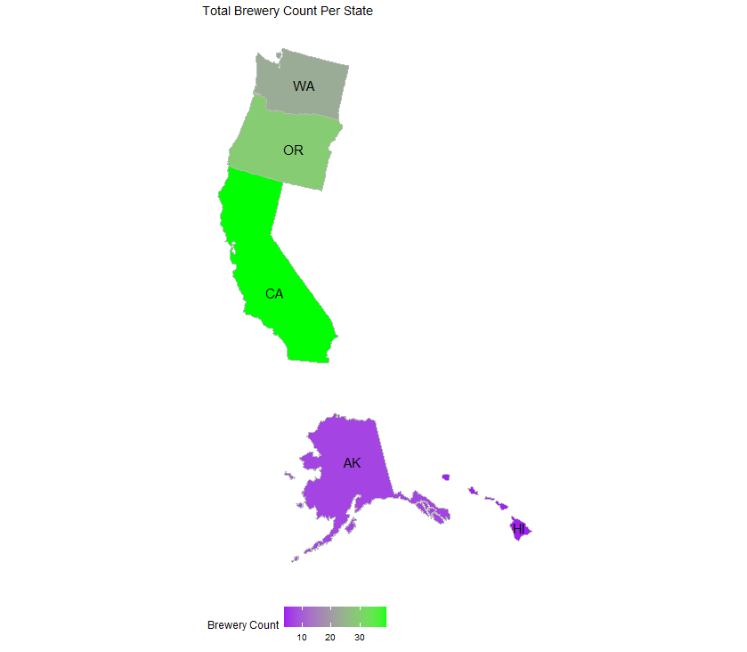
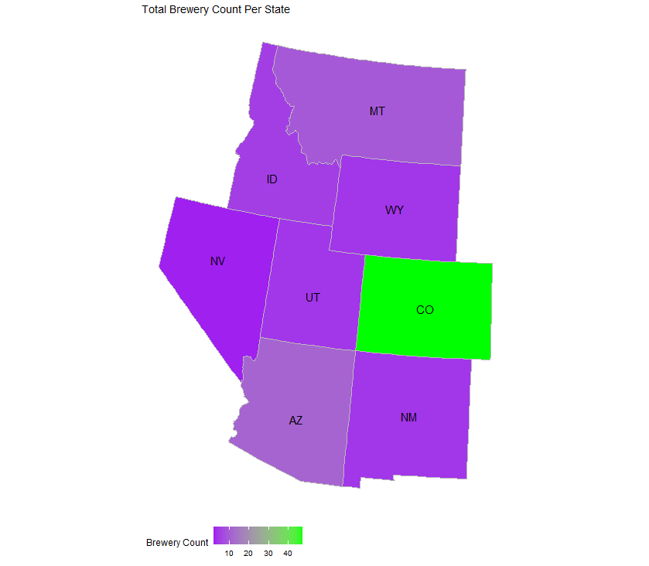
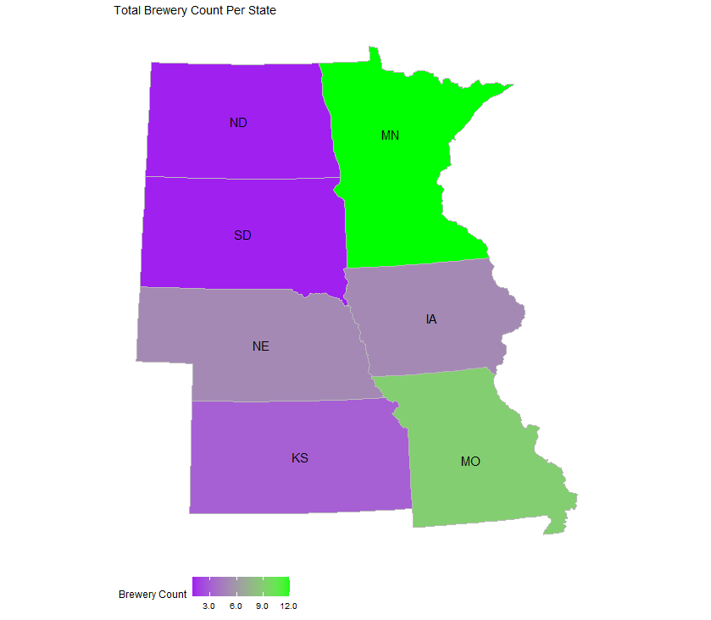
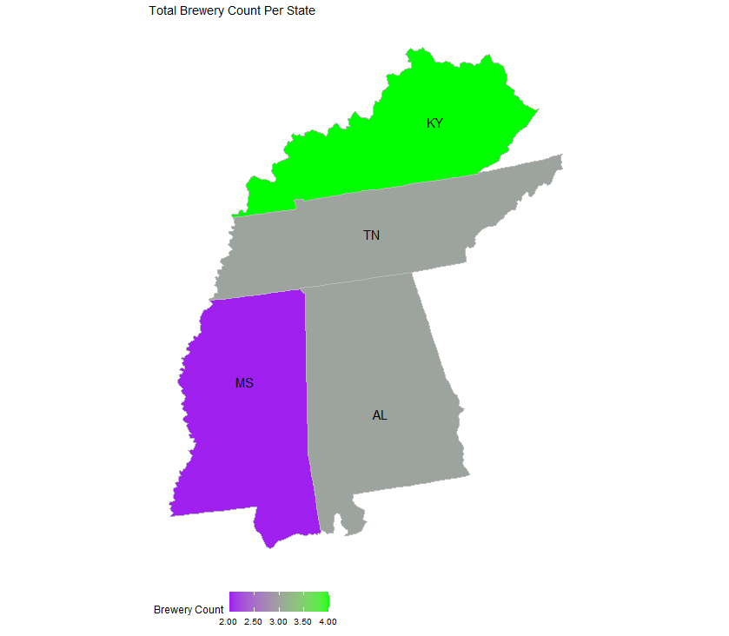
Breweries by State

Slide 4
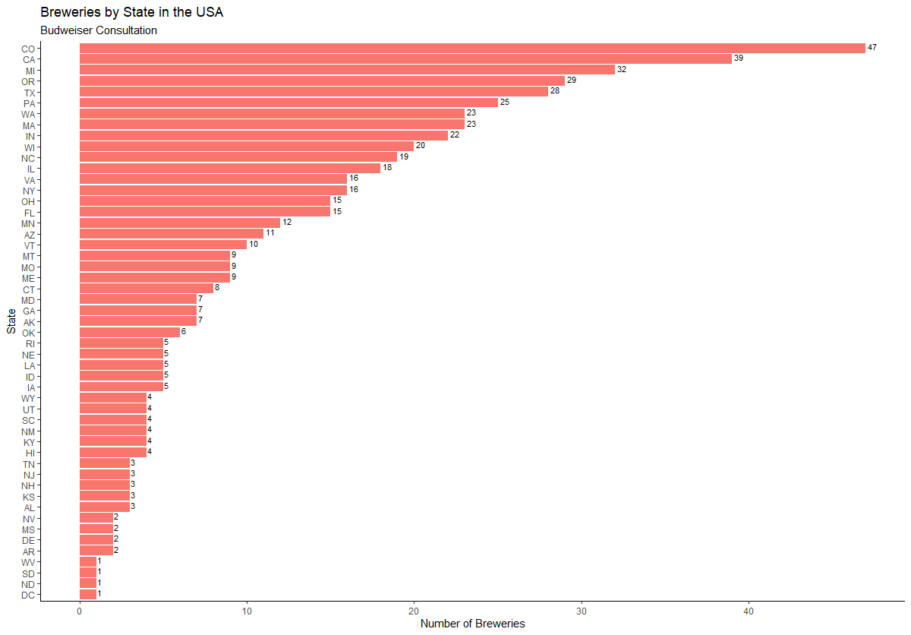
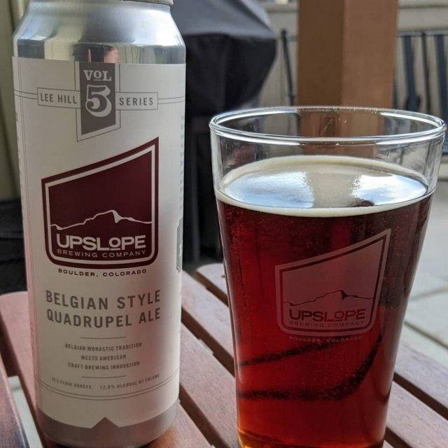
Breweries by State
Top 10 States by Brewery
Colorado -- 47
California – 39
Michigan -- 32
Oregon -- 29
Texas -- 28
Pennsylvania -- 25
Washington -- 23
Massachusetts -- 23
Indiana -- 22
Wisconsin -- 20

Slide 5
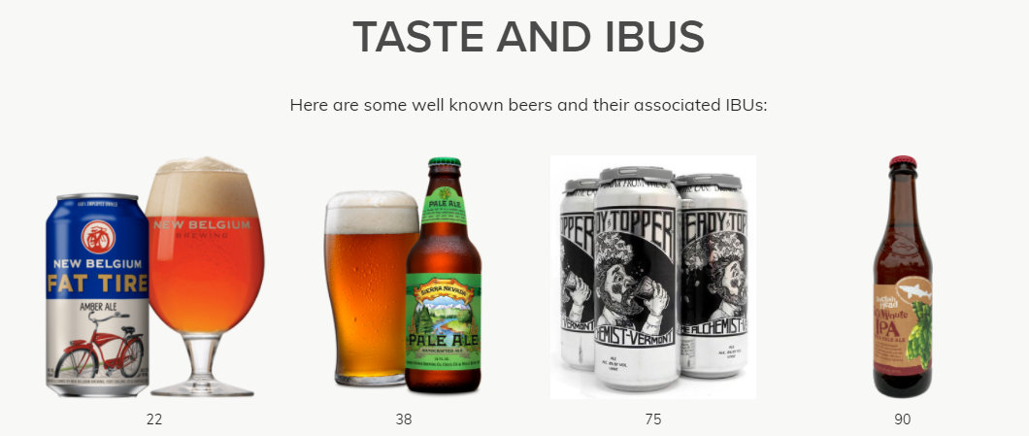
Missing Values
2 Options
Impute NA’s based on average of ABV/ IBU by Style
Disregard NA’s based on
IBU
Cost vs Relevance
Rating vs Taste
ABV
Legal Requirements (vary by state)
Availability (label approval vs packaging)
Photo Credit: https://www.thebrewenthusiast.com/ibus
Notes:
IBU
Smaller breweries cannot afford the equipment to measure IBU and therefore do not use it.
Large breweries can afford the necessary equipment to measure IBU, but tend to use the IBU scale for quality control
isn’t necessarily a true measure of bitterness taste, rather it is a measure of the chemicals in the beer that make it taste bitter (confounding variables can alter this measure though so a lower scoring IBU may taste more bitter than a higher scoring IBU – thebewenthusiast.com for example sites strong Amber ales having IBUs in the 60s that taste less bitter than Pale Ales with mid-50s IBUs
ABV
was actually illegal until 1995 when Coors sued to have it included in its packaging.
mixed and aged beers don’t know ABV until the time the beer is packaged, then it may or may not be stamped onto the bottom of the can, but not necessarily reported.

Slide 6
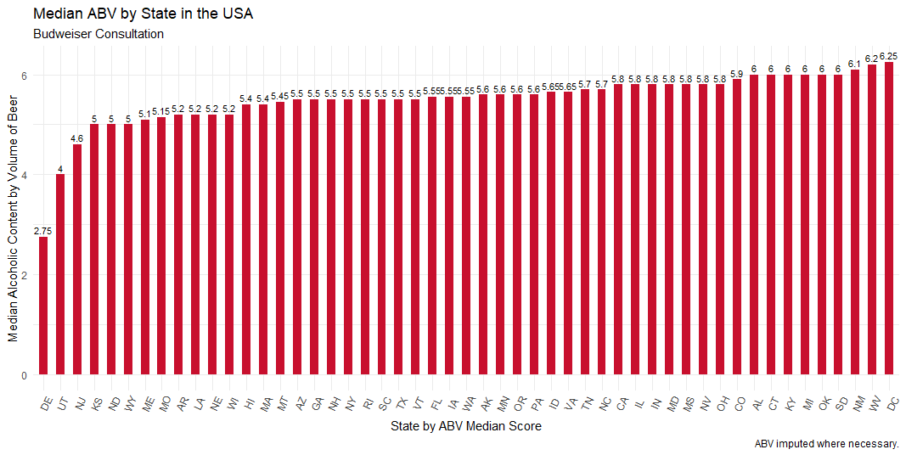
Median ABV by State

Slide 7
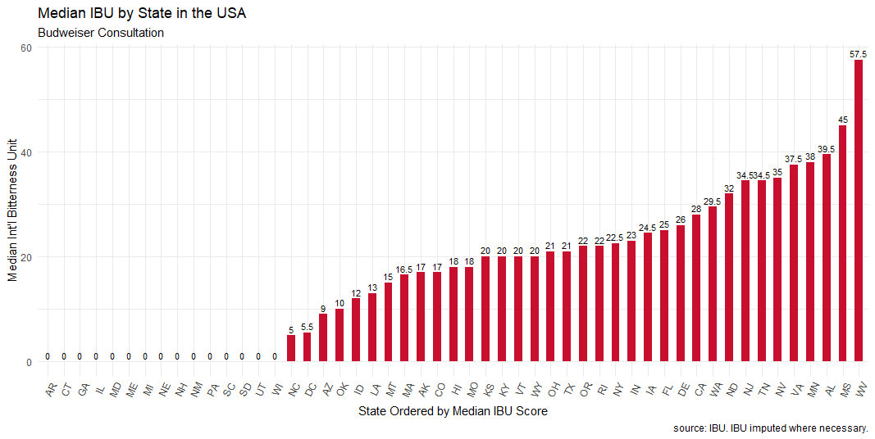
Median IBU by State

Slide 8
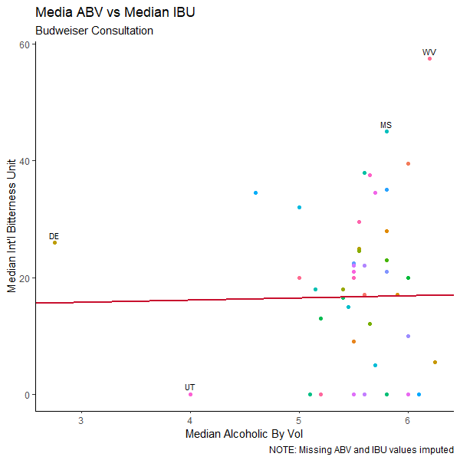
Median ABV vs Median IBU
Slight positive relationship between Median IBU vs Median AVB by state
Notable Outliers (Median ABV, Median IBU)
Upper (IBU> 40):
West Virginia ( 6.2% , 57.5 )
Mississippi (
Lower (ABV < 4.5):
Utah having the lowest (4%, 0)
Lower: Delaware (2.75, 26)
Overall median IBU = 18
Overall median ABV = 5.5%
Note:
West Virginia: ABV is 0.05% - 12.0% ABV for all malt based beverages (SOURCE:https://en.wikipedia.org/wiki/Alcohol_laws_of_West_Virginia#Raising_the_ABV%_Cap)
Utah: Max ABV is 4%, or 3.2 percent by weight for beer. (SOURCE: https://utah.com/state-liquor-laws#:~:text=The%20maximum%20alcohol%20content%20is,state%20liquor%20stores%20throughout%20Utah.)

Slide 9
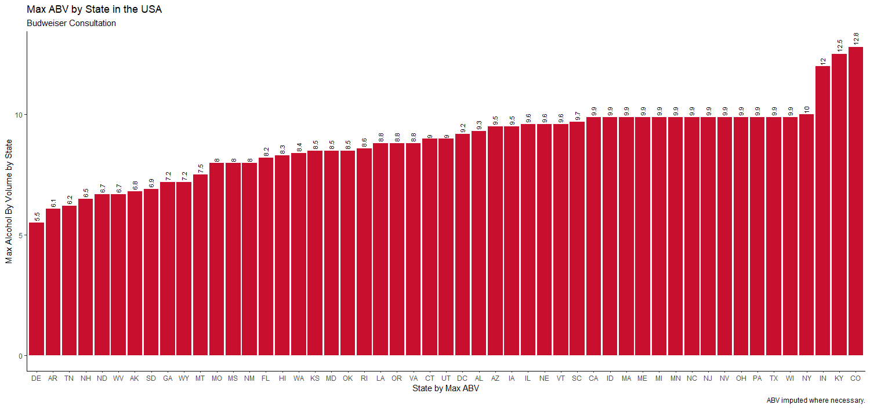
States with highest ABV
The Max observed ABV was 12.8 % in Colorado for Lee Hill Series Vol. 5 – Belgian Style Quadrupel Ale from Upslope Brewing Company in Boulder, CO.

Slide 10
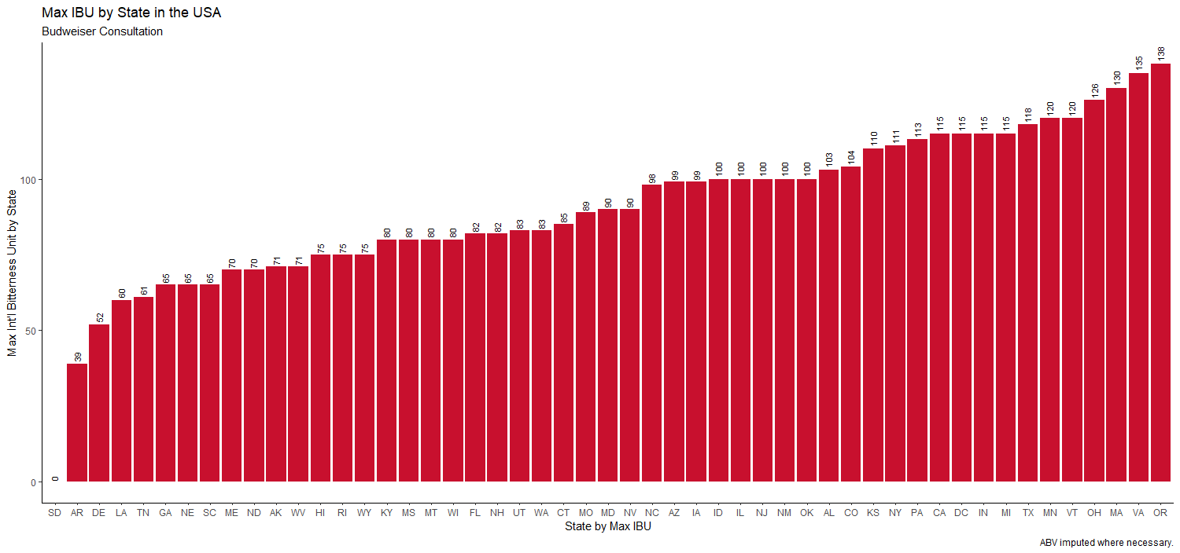
States with Highest IBU
The Max observed IBU was 138 in Oregon for Bitter Bitch Imperial IPA that is an American Double/ Imperial IPA from the Astoria Brewing Company in Austoria, OR.

Slide 11
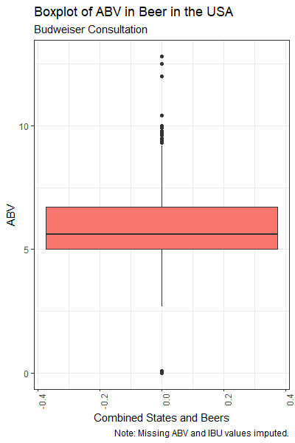
Summary Statics of ABV
In evaluating the ABV statistic for beer in the USA we find that there is a right (or upper) skew with some outliers far to the right.
The right outliers may be attributed to higher ABVs from higher IBU rated beers such as, Lee Hill Series Vol. 5 - Belgian Style Quadrupel Ale by Upslope Brewing Company in Boulder, CO (ABV = 12.8).
The left outliers are more than likely from products that either don’t report ABV or that we were not able to impute due to the beer being a very specialized or unlabeled style.
The box between the first and third quartile ( 5% , 6.7% ) is probably a very accurate reflection of mass produced beer such as Bud Ice (5.5%), Bud Light Platinum (6%), Natural Ice (5.9%), Bud Ice (5.5%), Budweiser (5%), Blue Moon (5%), Stella Artois (5%), Heinekin (5%), Pabst Blue Ribbon (4.74%) and Miller Genuinine Draft (4.6%).
Statistic | Value
Min. | 0.001
1st Qu. | 5.000
Median | 5.600
Mean | 5.824
3rd Qu | 6.700
Max. | 12.800
SOURCE: https://worldfood.guide/list/list_of_beers_in_america_by_alcohol_content_abv/

Slide 12
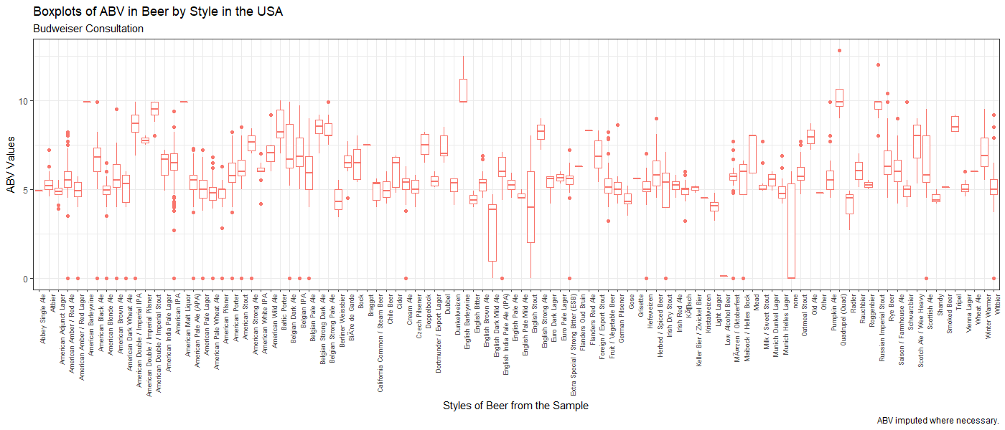
Summary Statistics of ABV

Slide 13
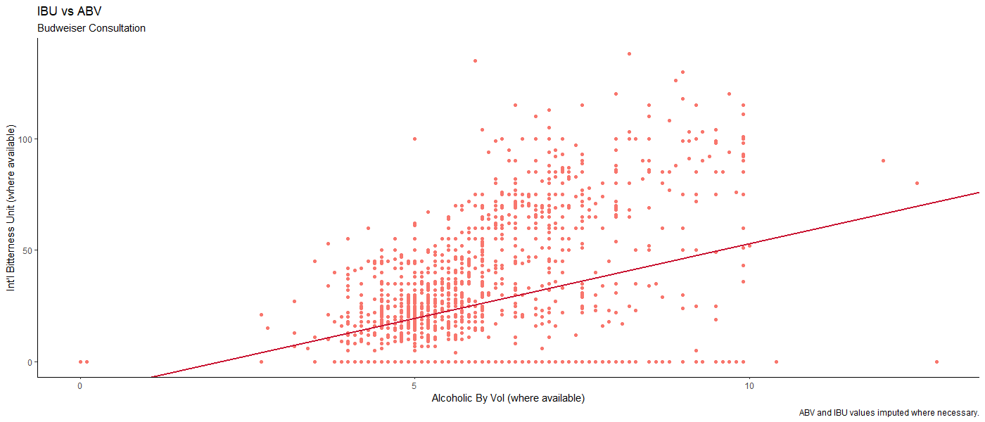
Relationship between IBU and ABV
There is visual evidence of a positive relationship between the IBU and ABV of beer in the USA.

